Slide 1
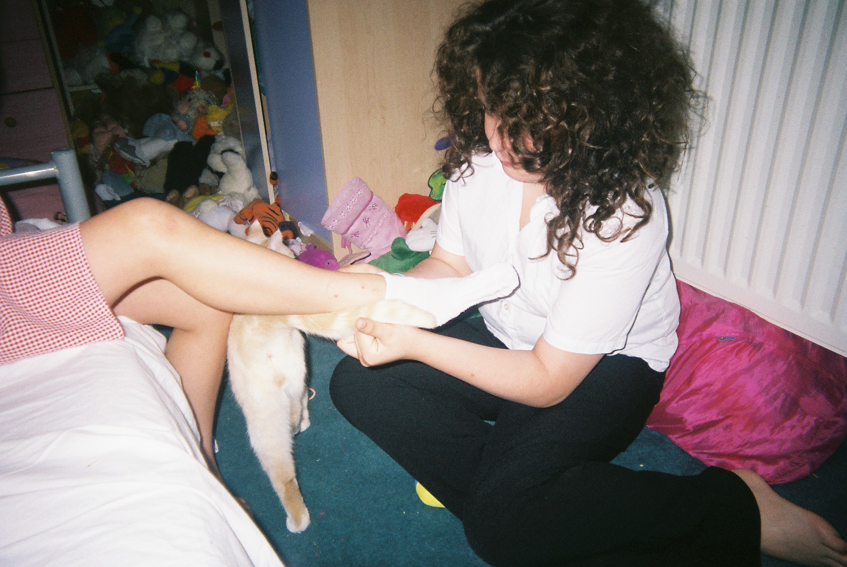

Parental Mental Health and Young Carers: Children (and Families) First
Professor Jo Aldridge
Young Carers Research Group

Slide 2

Research on young carers:
Early 1990s:
Small-scale
Quantitative – ‘known’ young carers
Estimates of prevalence relied on secondary data analysis (eg census surveys) and limited numbers of national studies
Figure anywhere between 188,000 to 700,000
Current national study: Young Carers in England (YCRG, Lboro and TNS-BMRB) funded by DfE
Prevalence of young carers in England
Impact on very young children (5-17 year olds)

Slide 3

Stats and strategies
At any one time around one adult in six is experiencing symptoms of mental illness and one in four will experience mental illness during their lifetime. Mental illness is the largest single cause of disability in our society and costs the English economy at least £77 billion a year.
Difficulties of gaining accurate picture of numbers of children caring for parent with mental health problems – relies on identification of MH and YCs and obstacles re fear of disclosure

Slide 4
“thousands” (MyCare)
“over one third of young carers” (BASW)
“just under a third (50,000)” Children’s Society
Think Family; No Health Without Mental Health
Care Act, 2014 and Children and Families Act 2014
Parental Mental Health and Child Welfare
Caring just one of the outcomes for children of living in families affected by mental illness – importance of understanding wider needs of children

Slide 5

Importance of other (systemic) factors…
e.g. poverty/low income (social exclusion):
‘Children in low-income working families were often taking on additional responsibilities in the home, including housework and caring responsibilities, or engaged in paid work themselves to ease financial pressures at home and to gain access to their own money’ (Ridge, 2009, p. 4)

Slide 6
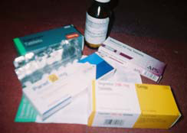
Our research (YCRG):
2003 study with Rethink:
Children caring for parents with mental illness: Perspectives of young carers, parents and professionals
2007 study:
http://www.ycrg.org.uk/youngCarersDownload/Pictures%20of%20young%20caring%20research%20report.pdf

Slide 7

Research tells us:
That mental health professionals and primary care practitioners (General Practitioners, for example) largely overlook the needs of children. Some do not even know whether their adult patients are parents
That children can and do experience adverse outcomes of parental mental illness, including increased risk of developing mental illness themselves, stigma and discrimination, poor school performance, poor transitions into adulthood

Slide 8

But should not just be about risk
Too often assumptions made by professionals that risk to children is inevitable, because of mental illness itself.
Dangers of ‘TT’ assumptions
Takes us backwards:
“We therefore find families that are disorganised, suspicious, chaotic and fluctuating…within the interpersonal matrix, a great deal of psychopathology can develop insidiously within individuals, especially children…family life because coarsened and the dirt and disorder are no longer noticed” (Anthony, 1970, p. 62).

Slide 9
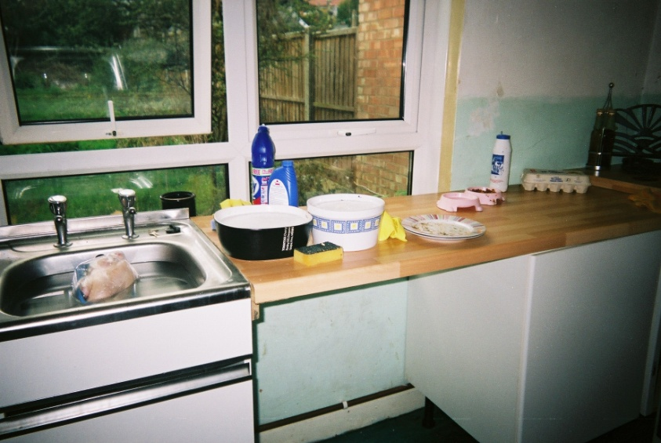
Research that focuses on the social model of mental illness and on the welfare of parents AND children shows that other factors increase or exacerbate these risks and adverse outcomes
These include:
The impacts of multiple disadvantage or social exclusion (poor housing, poor neighbourhoods, low income, poverty etc)
Patient-focused interventions and services – lack of holistic, whole family, approach

Slide 10
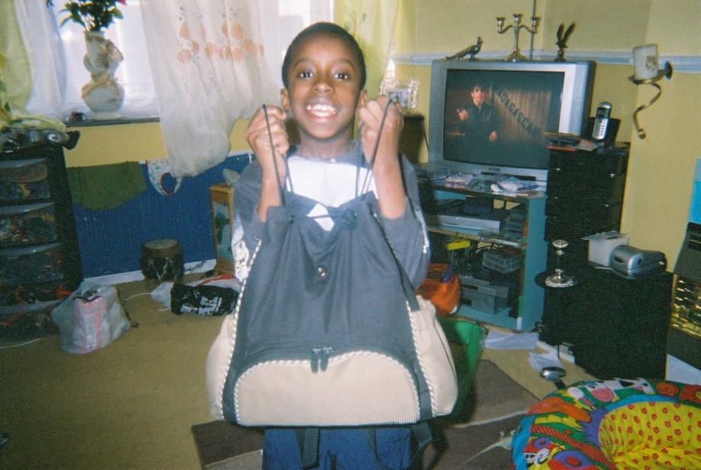
And...
Children can have close relationships with parents who have mental health problems (even long term problems)
Children often want to care (to some extent) for their parents but they need help and support for themselves as well as family support
Children need greater understanding about their needs when they live with, and care for, parents with mental health problems
Especially from school staff, peers, local communities and particularly from health and social care professionals
Notes:
Different ways of demonstrating this, including in research that uses different, participatory (child friendly) methods

Slide 11
Some of the things I do are look after my younger sisters and I have to rub my mum’s feet, because you have to push the circulation through. They showed me how to do it….to relief my mum’s pain. I have to help my mum with her medication and injections. That’s me helping the girls get ready for school in the morning. We take it in turn washing the pots from Sunday dinner. We take it in turn during the week, me and Ben as well. We all take it in turns. (Lucy, 14)

Slide 12
That’s a picture of my mum and dad; you just want to hug them. I’m a carer for my mum. On a really, really, really, bad day I will be doing absolutely nearly everything. Dressing her, doing washing, vacuuming, cleaning, and loads of
things. These two weeks why I did not show anything in these photos is because these two weeks were perfect, they’ve been very good. What dad does is try and get money so he comes up with some weird and wonderful things, and he’s trying to get on the market. He’s always trying to do something new. He’s trying to just get some money in. (Fiona, 13)

Slide 13

And need to focus on children’s own mental health and well-being
Research on mental health and well-being of children caring for parents with mental health problems in Manchester (used Warwick and Edinburgh Mental Well-Being Scale) showed importance not only of whole family approach but also:
Need for early identification of children living in families affected by parental mental illness
Importance of prevention – ensuring children are not drawn into inappropriate caring roles (and, where established, to reduce these)
Caring has adverse consequences for children’s lives where caring unrecognised, unsupported for more than two years (statistically significant)
http://www.ycrg.org.uk/youngCarersDownload/MCF_Full_Report_2.pdf

Slide 14

References:
Abraham. K. and Aldridge, J. (2010) Who cares about me? The mental well-being of young carers in Manchester, Manchester Carers Forum, YCRG, NHS Manchester.
Aldridge, J. and Becker, S. Children caring for parents with mental illness: Perspectives of young carers, parents and professionals, The Policy Press, Bristol, 2003.(ISBN 1-86134-399-X)
Aldridge, J. and Sharpe, D. (2007) Pictures of young caring, YCRG, ESRC.
Mental Health Foundation (2015): http://www.mentalhealth.org.uk/help-information/mental-health-statistics/children-young-people/
Ridge, T. (2009) Living with poverty: A review of the literature on children’s and families’ experiences of poverty, Department for Work and Pensions, Research Report number 594.
[note: Anthony,E.J. (1970) quoted in Aldridge and Becker, 2003, p. 6)

